Slide 1
Space Wars
Space-Race inspired Qt & C++ based Arcade Game | August 2023

Slide 2
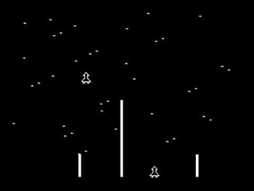
Space Race
Atari’s Arcade Game from 1973
Navigates the screen while avoiding asteroids
If you collide with an asteroid, you need to restart from bottom
Once you reach the top, you get points
[1] https://tvtropes.org/pmwiki/pmwiki.php/VideoGame/SpaceRace

Slide 3
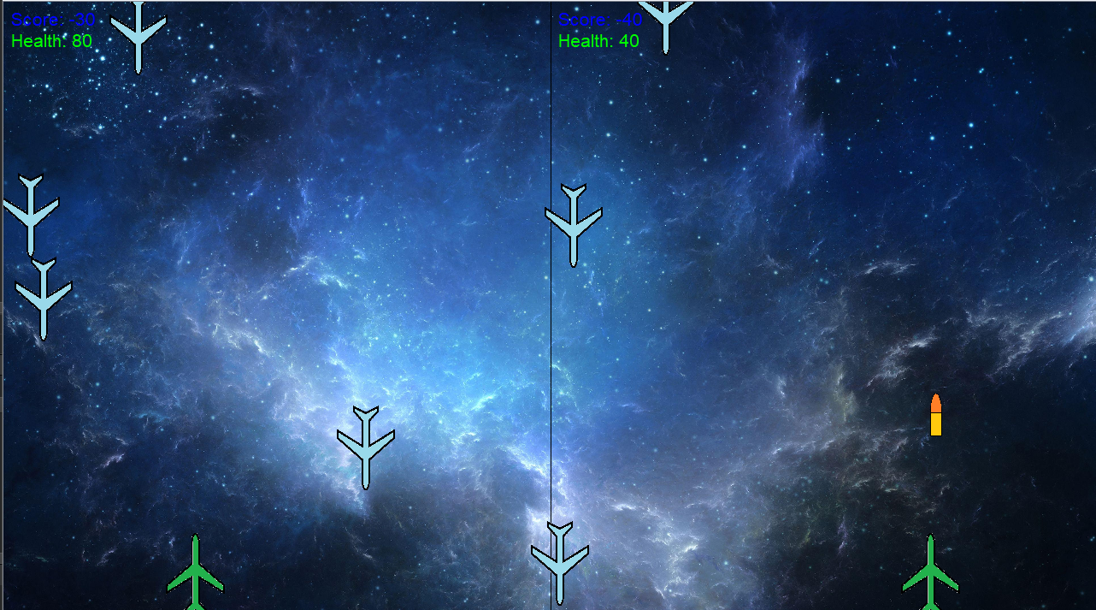
Game Rules
Shoot enemies to get points
Lose points when enemies go past the player
Lose health when enemies hit the player
Player dies when health becomes 0
The last survivor wins the game

Slide 4


Player logic
Health
Player Spawns
Decreases when hit by enemy
Player killed if health = 0
Enemy spawns
(randomized)
Bullet
Score
Increases when enemy is hit
Left
Right
Decreases when enemy reaches ground
Keys mapped into player input

Slide 5
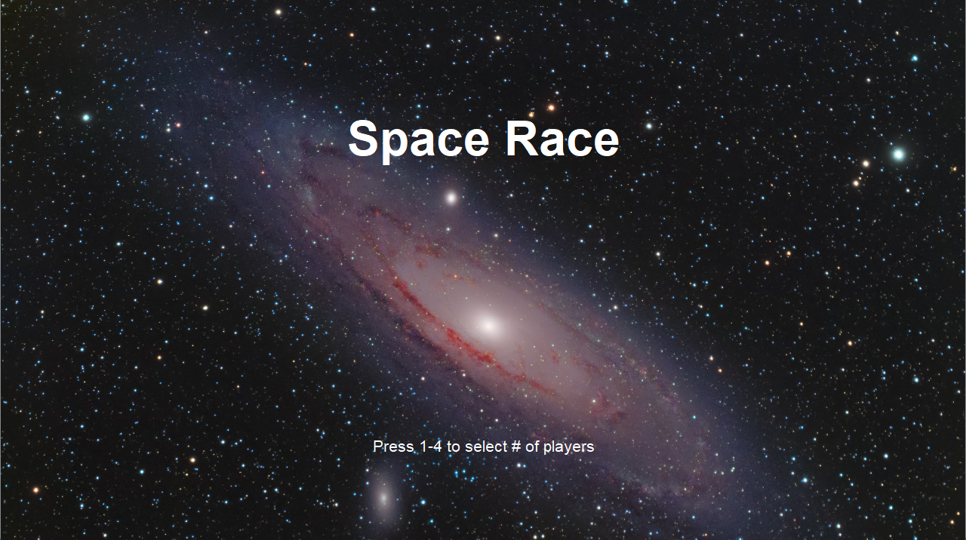
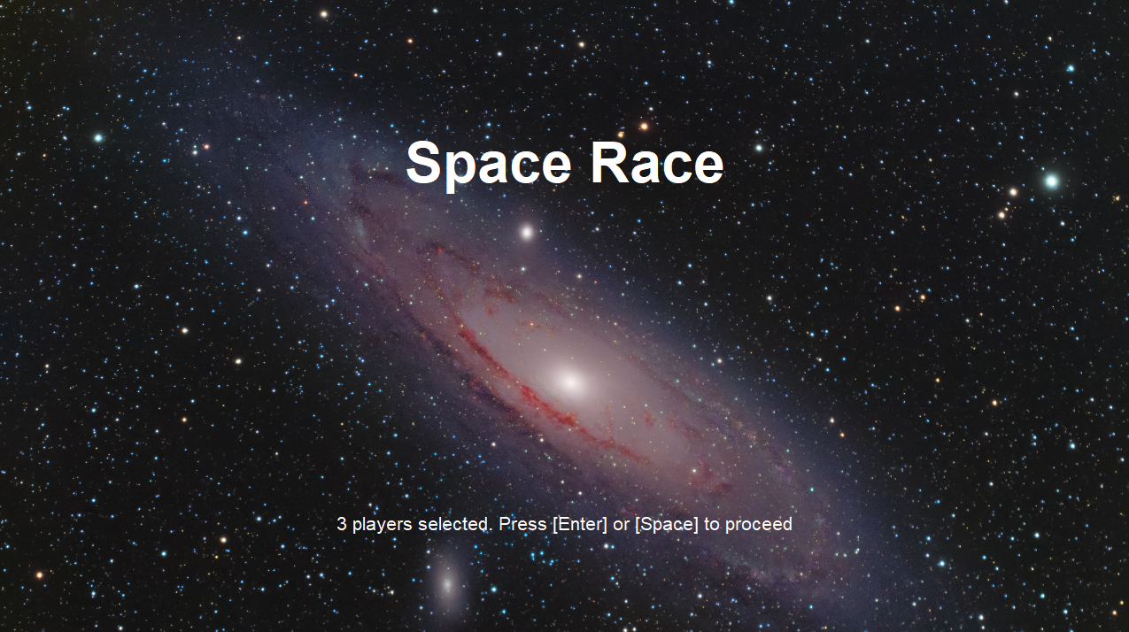
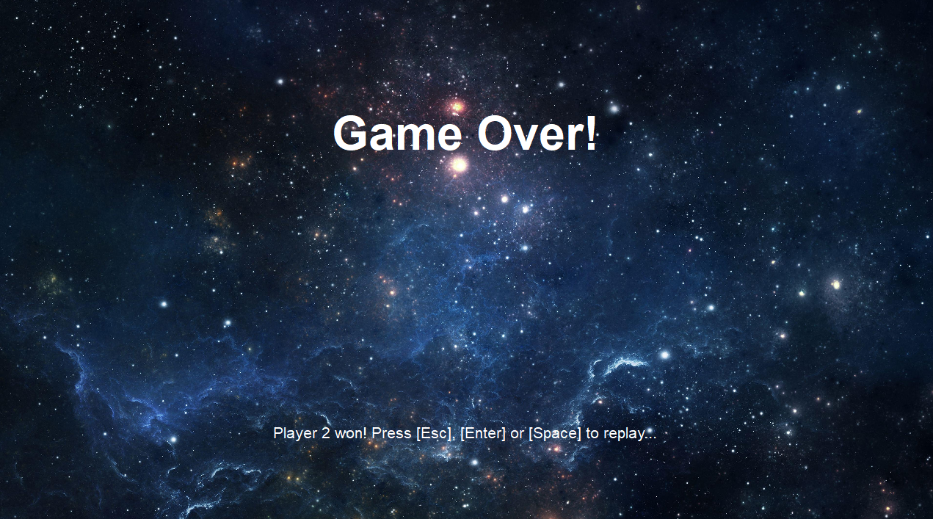
Game logic
Press Esc
Start Screen
(startScreen)
Transition
(startTransition)
GAME
(gameRunning)
GAME OVER
(gameOver)
Press Enter or Space
One player left (multiplayer)
Player dies
(single)
Select # of players
(1-4)
Press Enter, Space or Esc

Slide 6
Possible Improvements / Feature Additions
Return to the starting screen once all the players are killed
Announce the winner if only one player survives (when there are 2+ players)
Accept multiple keys at the instant so that the multiplayer mode can be smoother
Add variations to enemies (more/less damage, shoot bullets back, etc)
Add other items - health refuel, x2 points, etc
Add difficulty
Give options to users about resolution

